Slide 1
Covariance and Contravariance

Slide 2
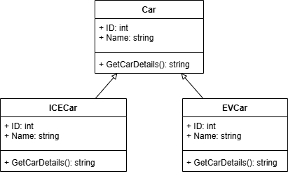
Overview
Less Derived
More Derived

Slide 3
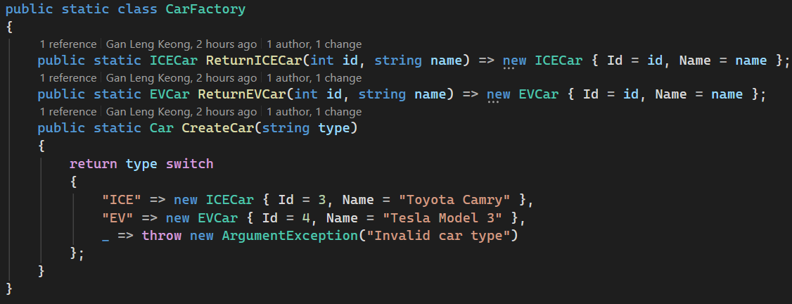
CarFactory: Factory Pattern
A factory that provide method to generate ICECar and EVCar
Contain method to create car based on given type

Slide 4
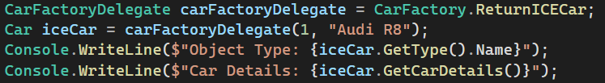

Covariance 协变 More →Less
The delegate only want a return type of car
Used more derived to return to delegate’s request

Slide 5
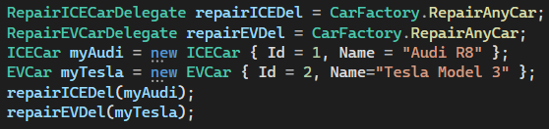

Contravariance 逆变 Less → More
The delegate mention specific type car as parameter
The method accept base class as param
The delegate able accept the method since it accept car type which is base class of ICECar and EVCar
repairEVDel will report error as it only accept ICECar type param

